Slide 1
Databricks
Azure Blob Storage > Databricks (Transformation) > Azure SQL Server

Slide 2
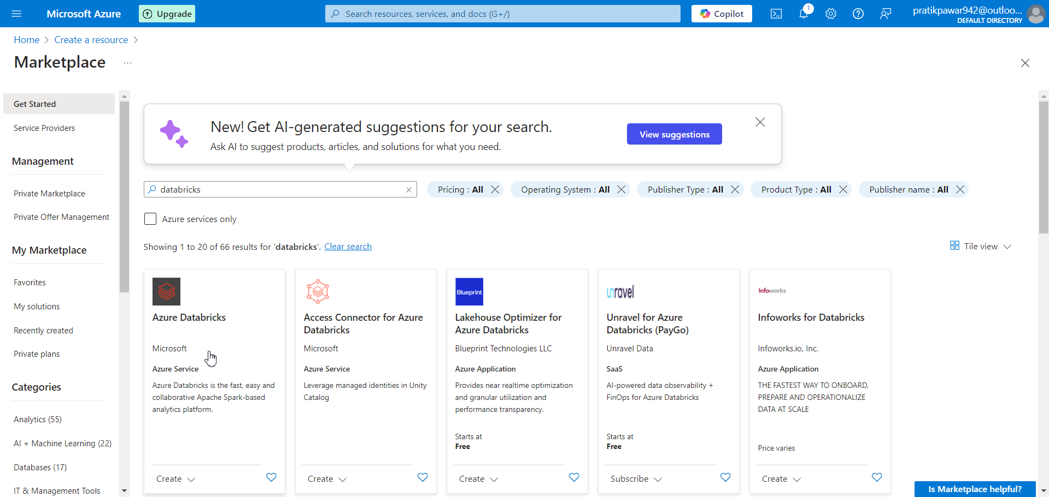
First We will Create Azure Databricks

Slide 3
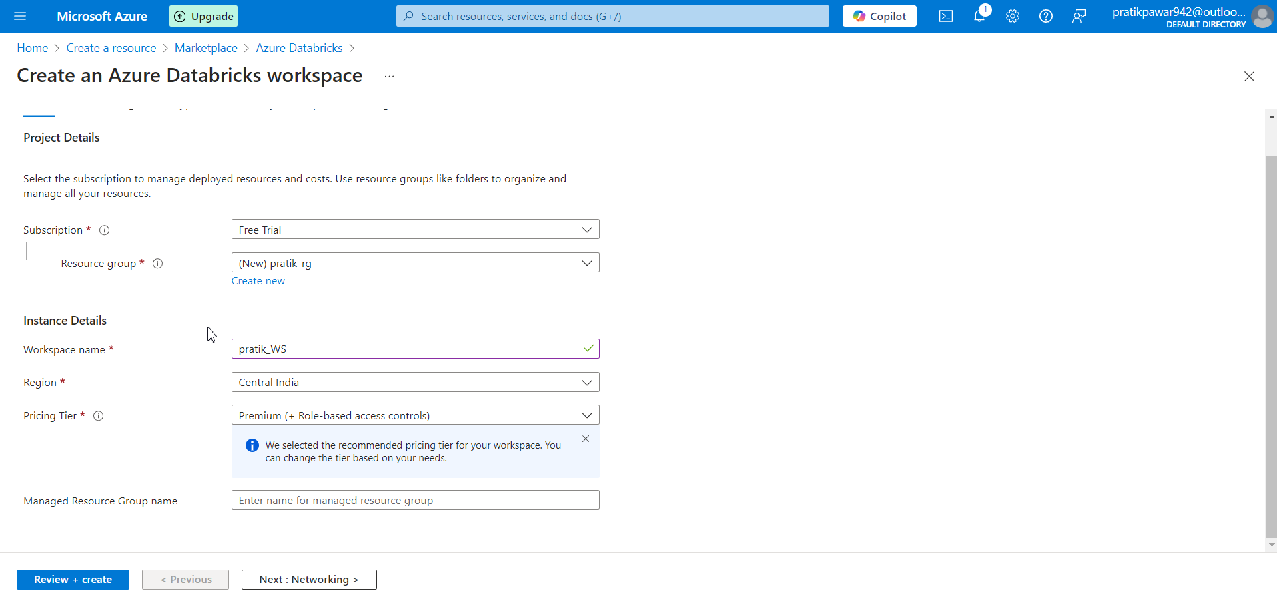
Create

Slide 4
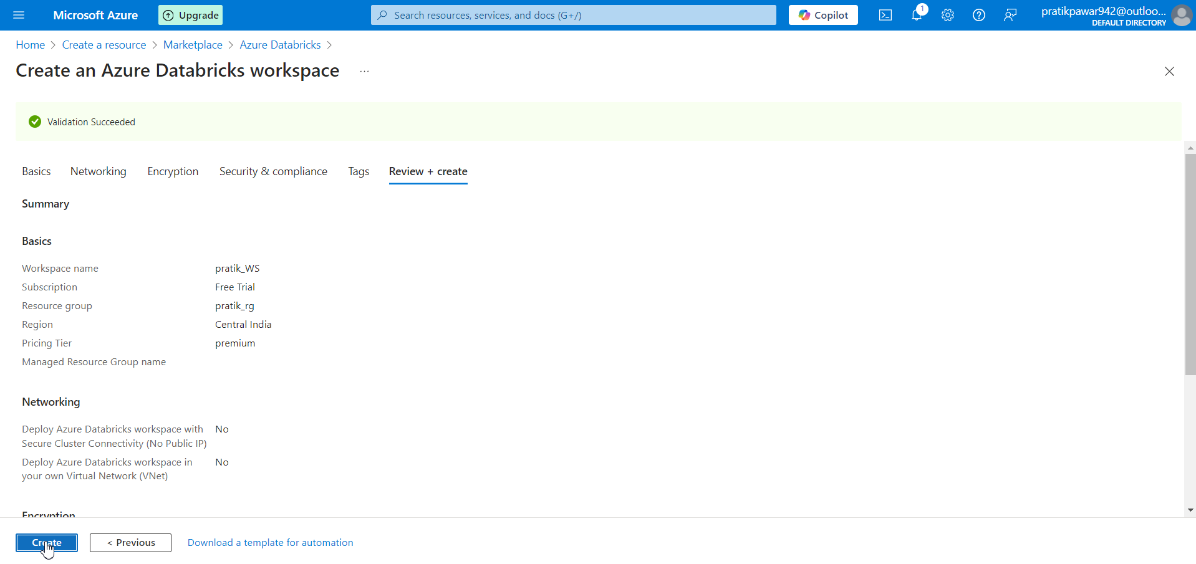
Review + Create

Slide 5
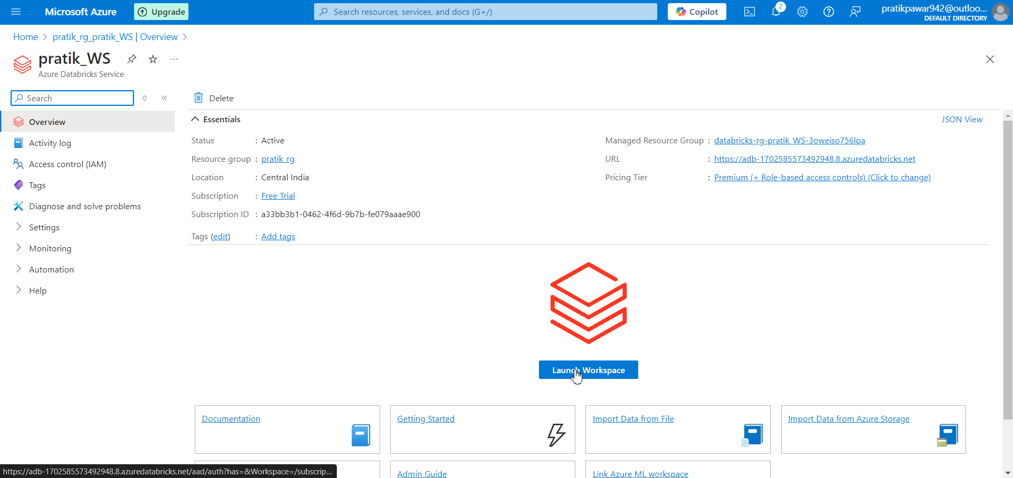
Launch WorkSpace in Databricks

Slide 6
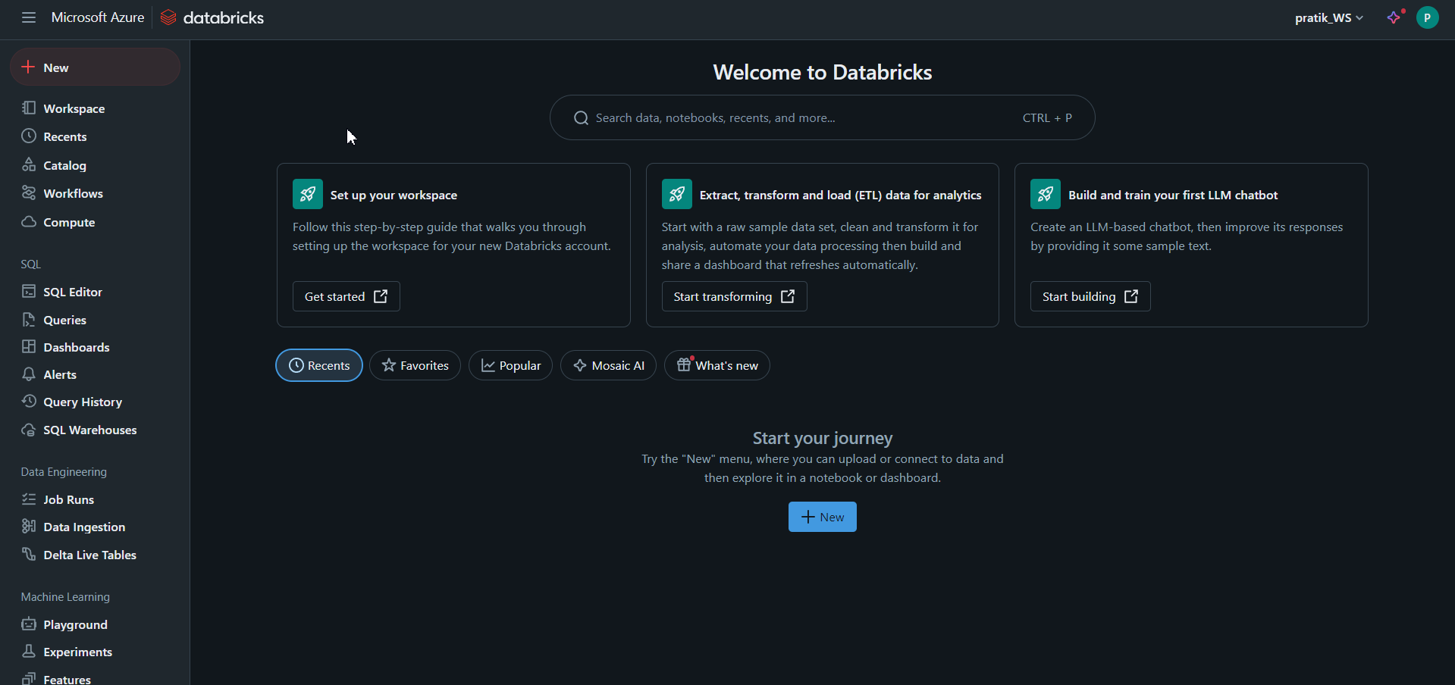
Work Space of Databricks

Slide 7
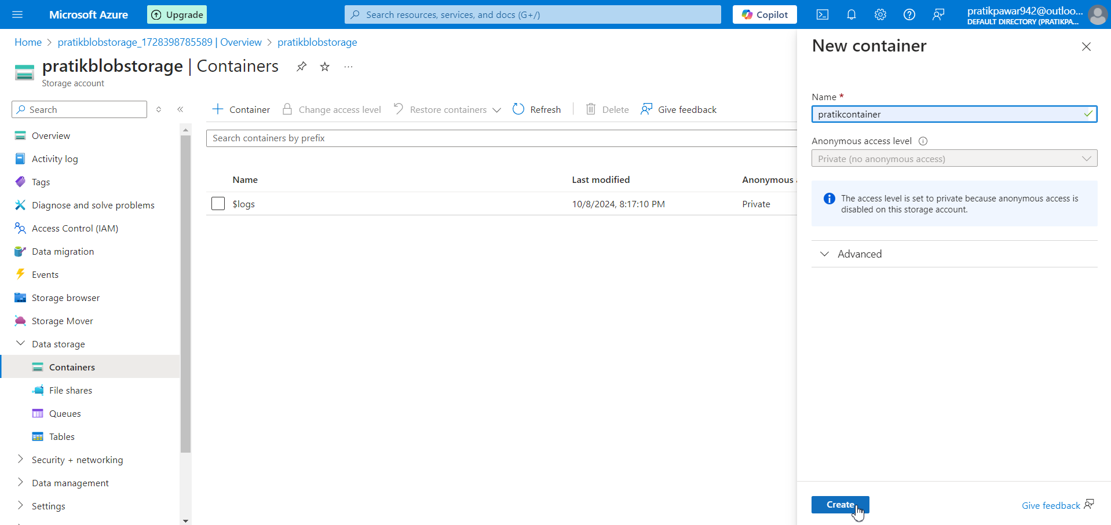
Create Container in Azure Blob Storage

Slide 8
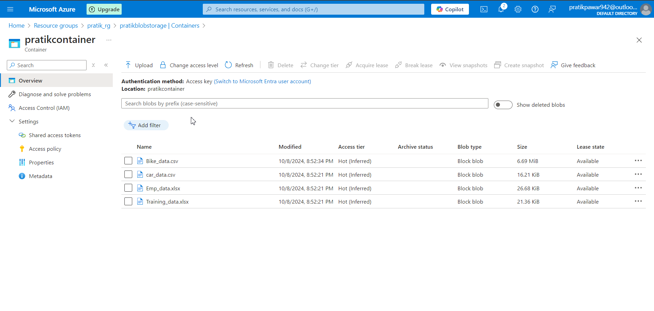
Uplaod the Raw Data which we want to Transform

Slide 9
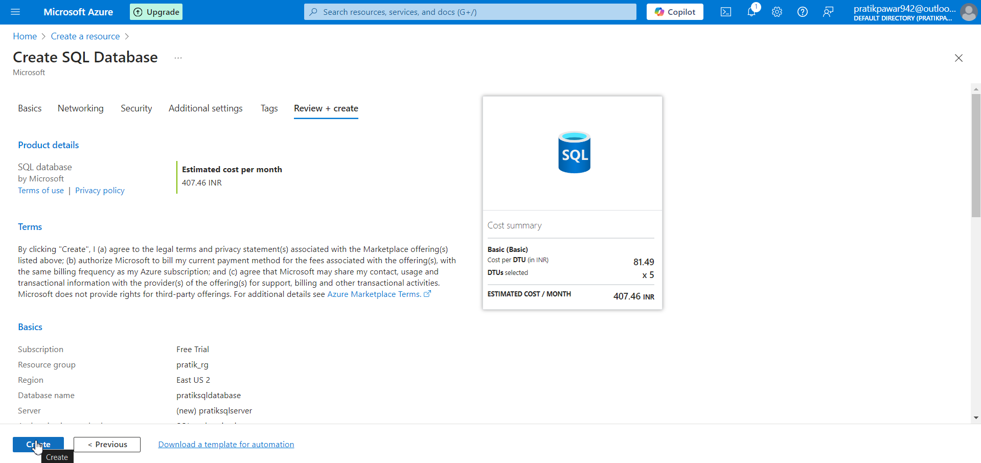
Also Create SQL Database

Slide 10
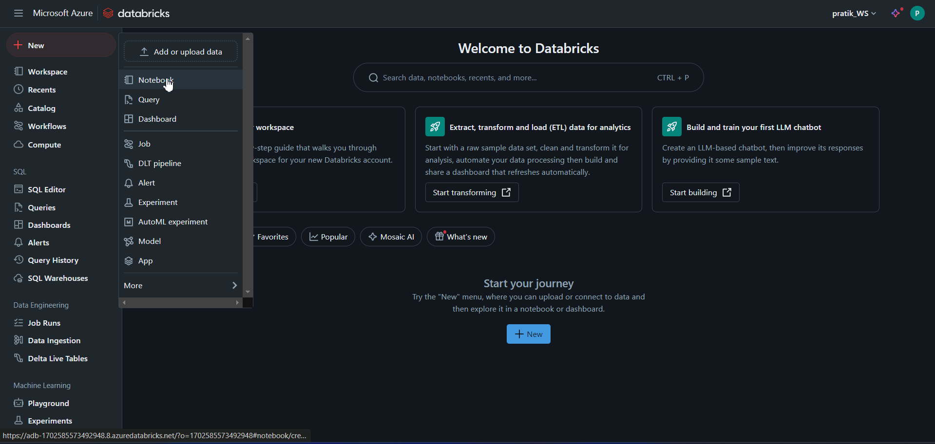
Now Go to NEW > Create One Notebook

Slide 11
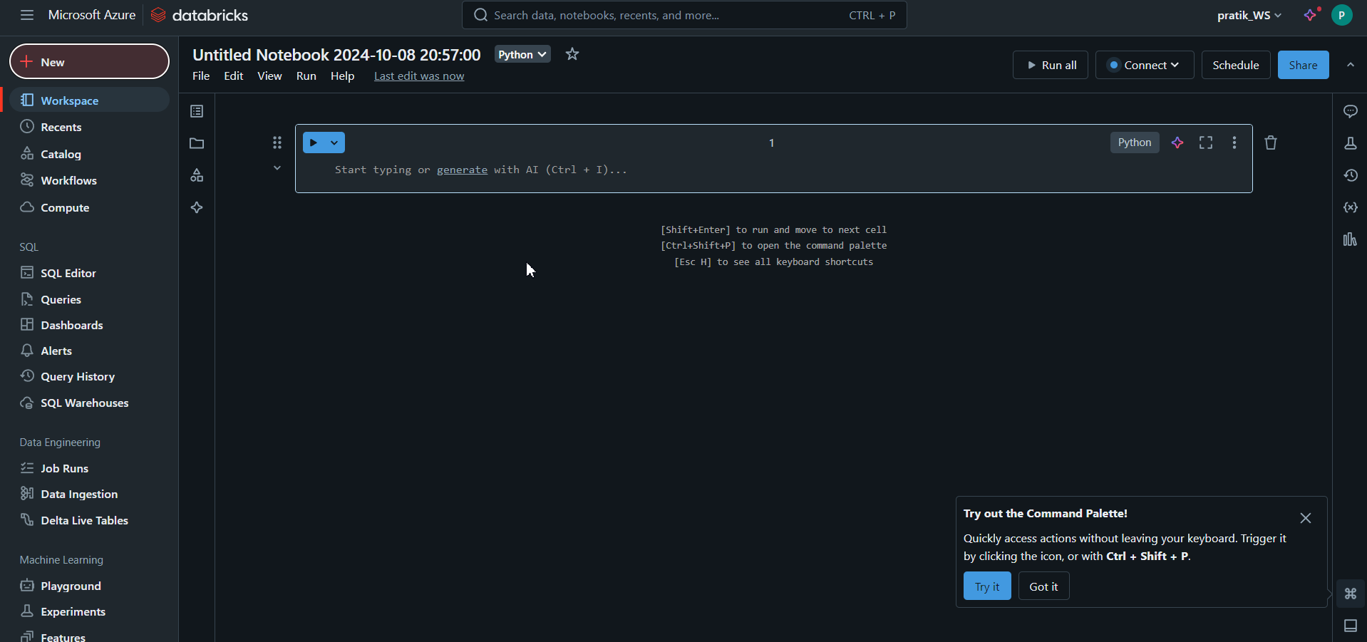
Now here We have to call the Data from Blob Storage , do the transformation and then push Data to Azure SQL Database

Slide 12
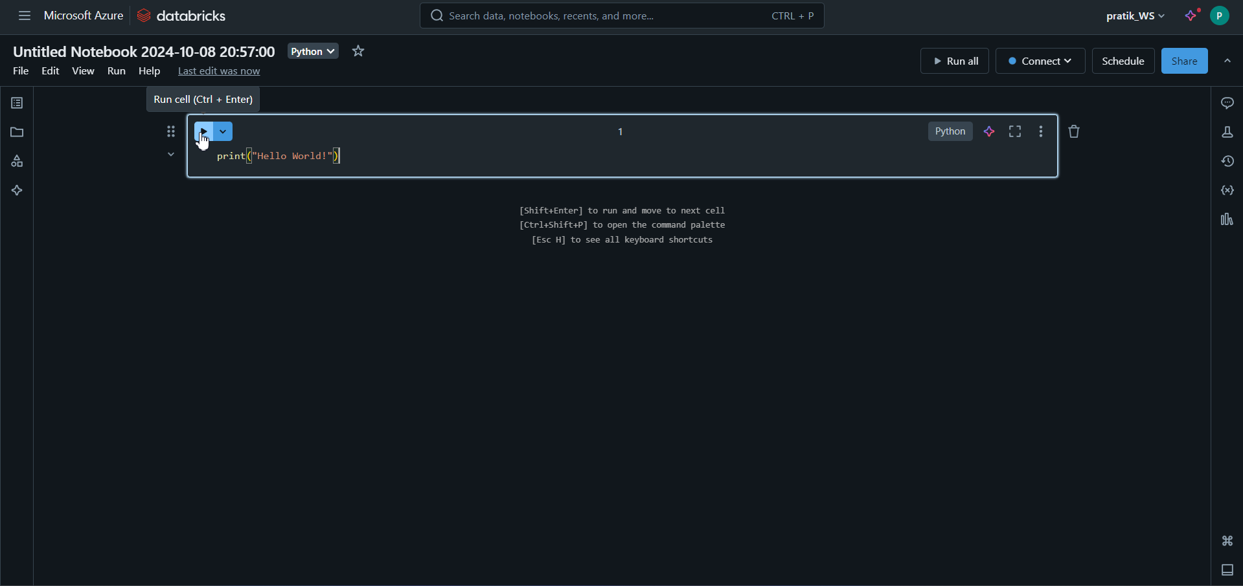
Now if we type print(“Hello World”) and Run it then,

Slide 13
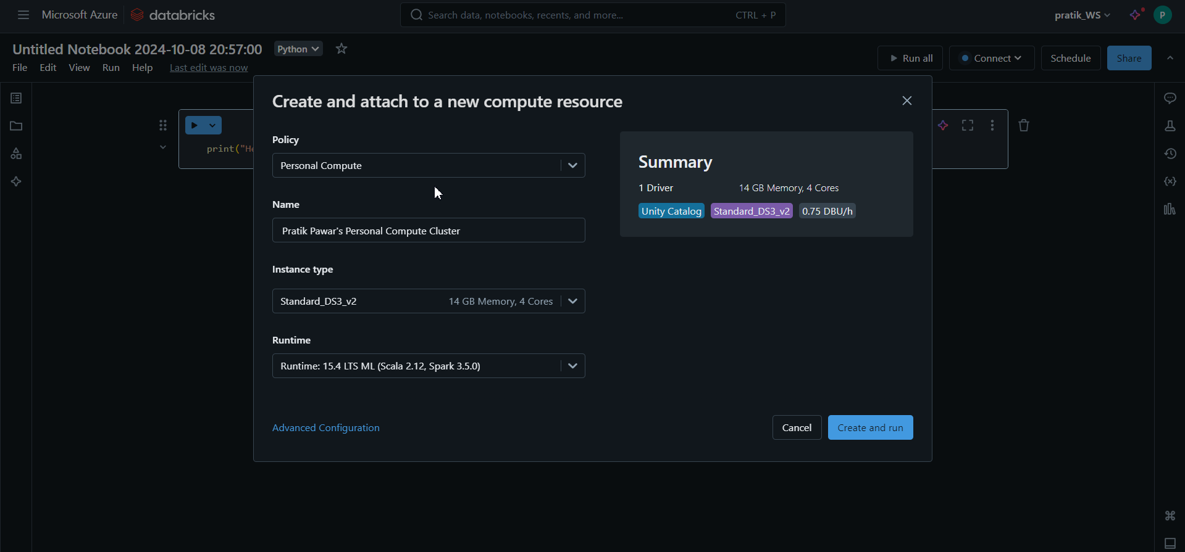
It will tell us to create Engine for this Notebook workspace according to environment

Slide 14
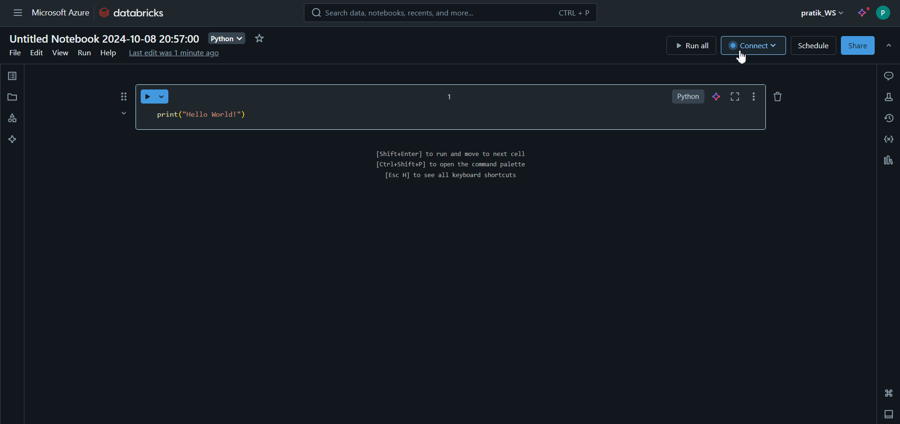
Also we can go through ‘connect’

Slide 15
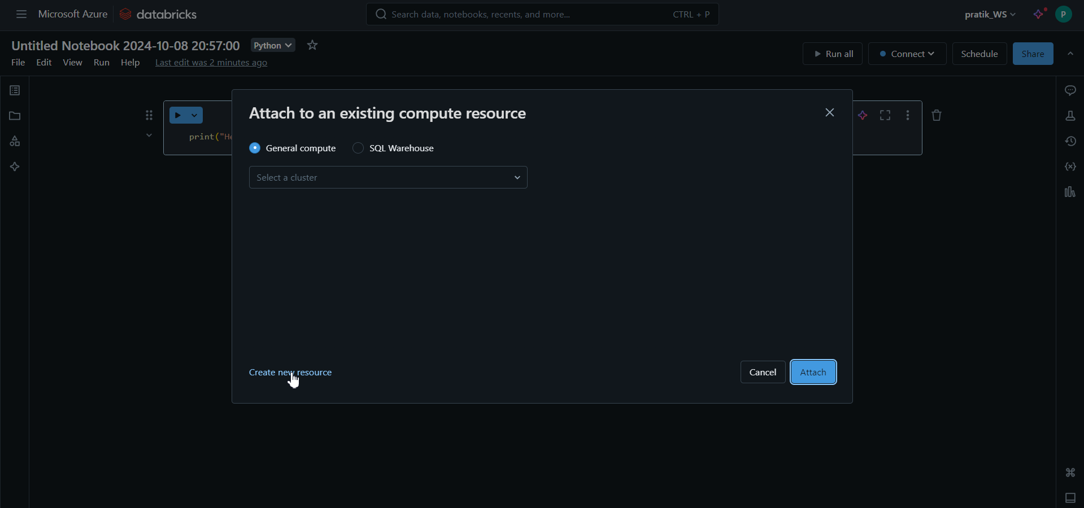
Create new resource ie cluster

Slide 16
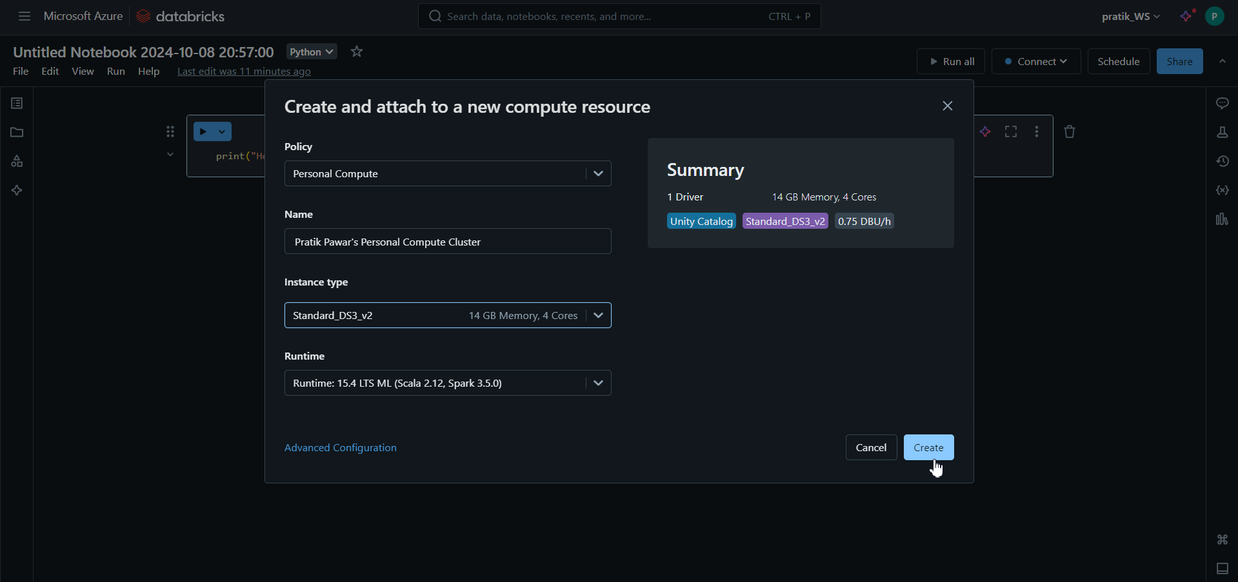
Adjust all the Information required and Create Cluster

Slide 17
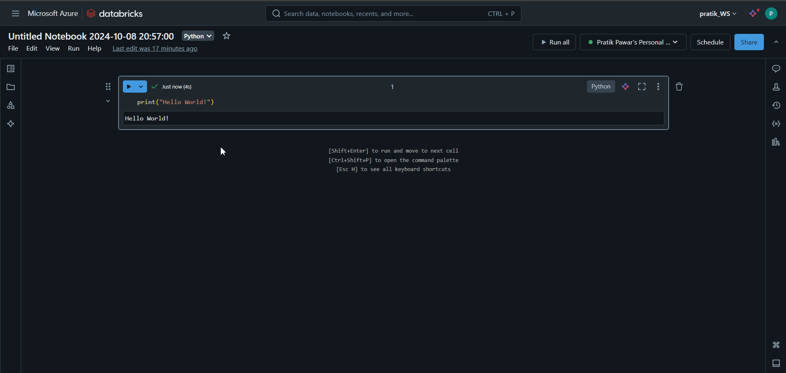
Now this time Code ran Successfully

Slide 18
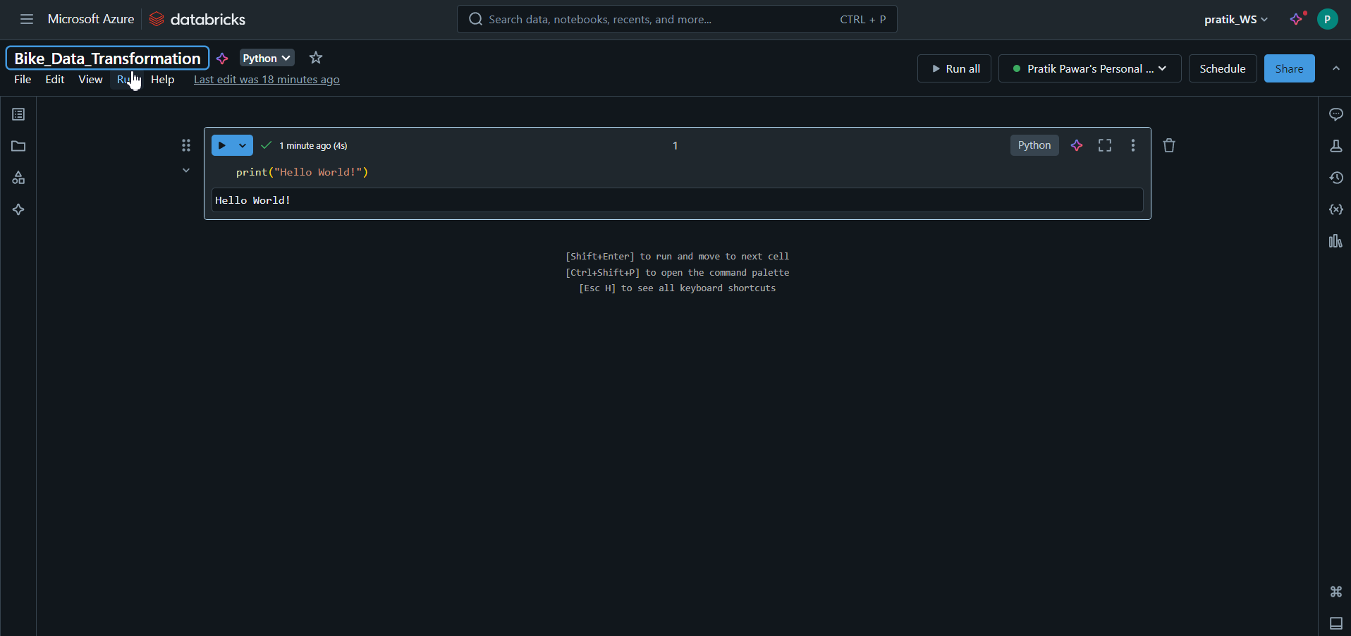
Give notebook name as ‘Bike_Data_Transformation’

Slide 19
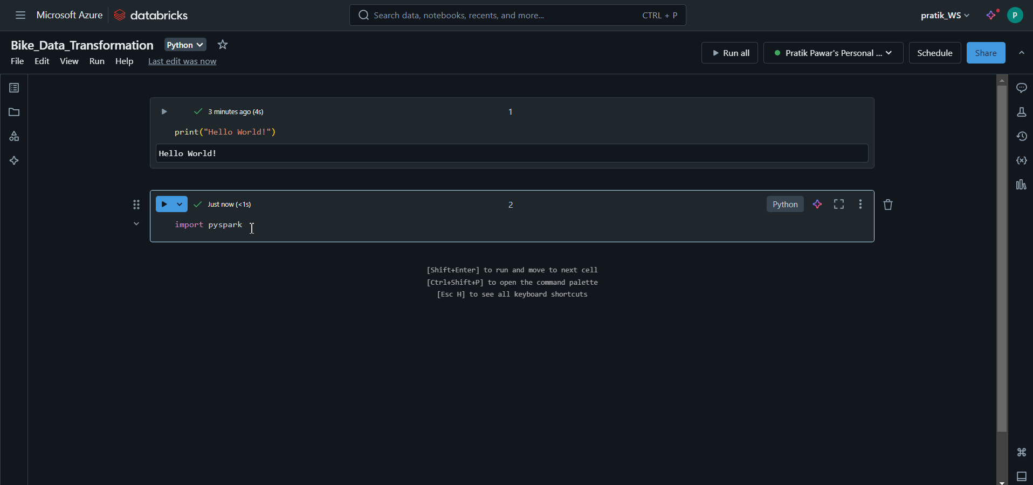
In this, it is not required to run Boiler Plate Code of Pyspark, we can directly import Libraries

Slide 20
How to get Data from Storage to Databricks
Access Key /Account key( Most Used) (We will Use this)
SAS Tokens
Service Principal
Micro-Entra ID /Azure Active Directory (AAD)
Mount Method (Most Used)

Slide 21
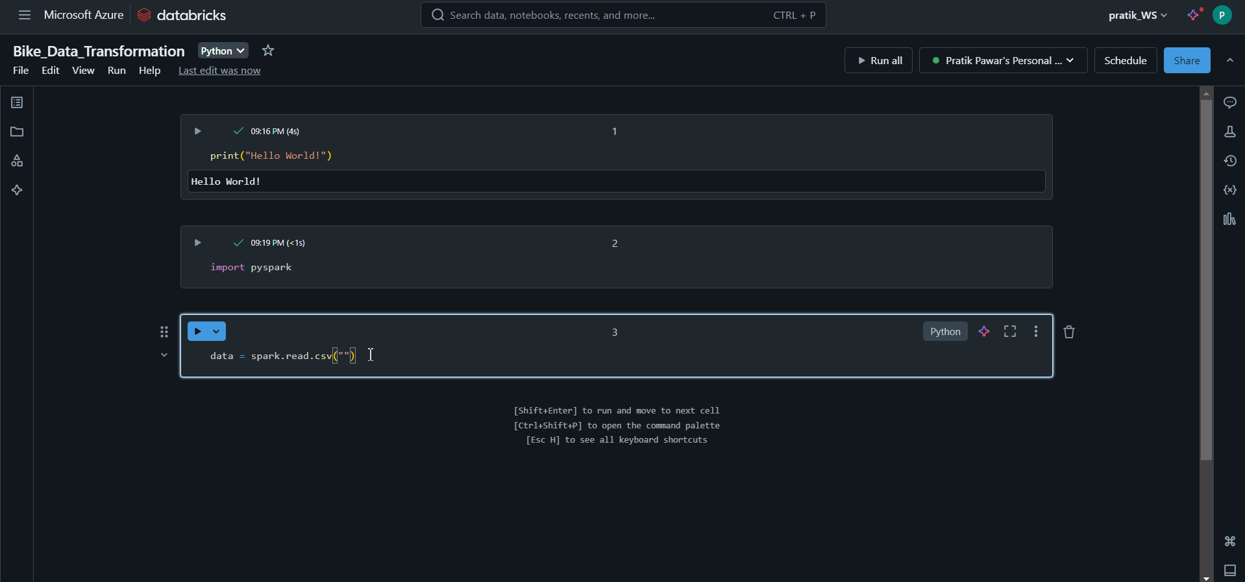
Now this is code for reading data but we have to give path of Blob Storage

Slide 22
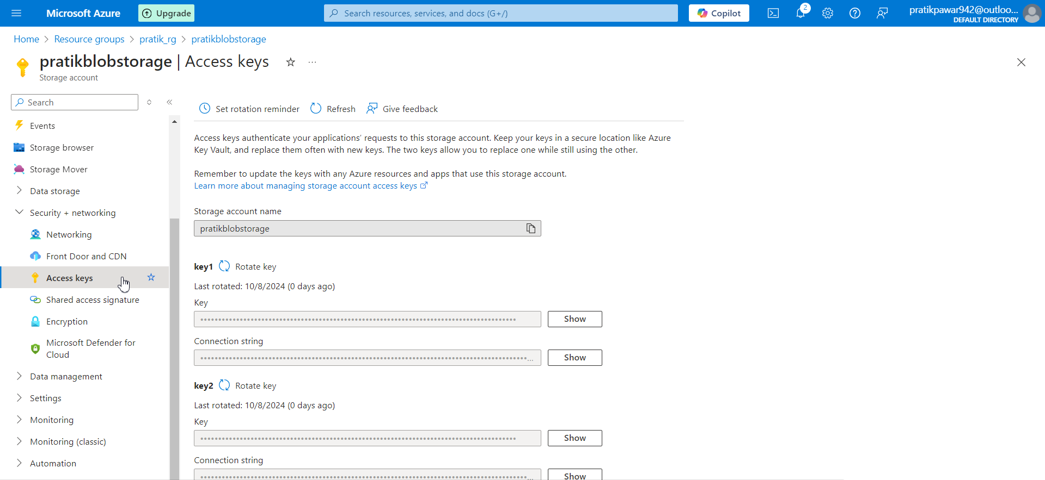
Now go to ‘Access Keys’ its like password from where we can get Data into Databricks

Slide 23
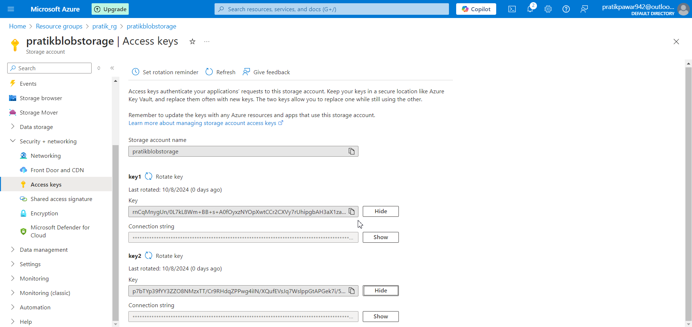
Here are two keys we can use which ever we want

Slide 24
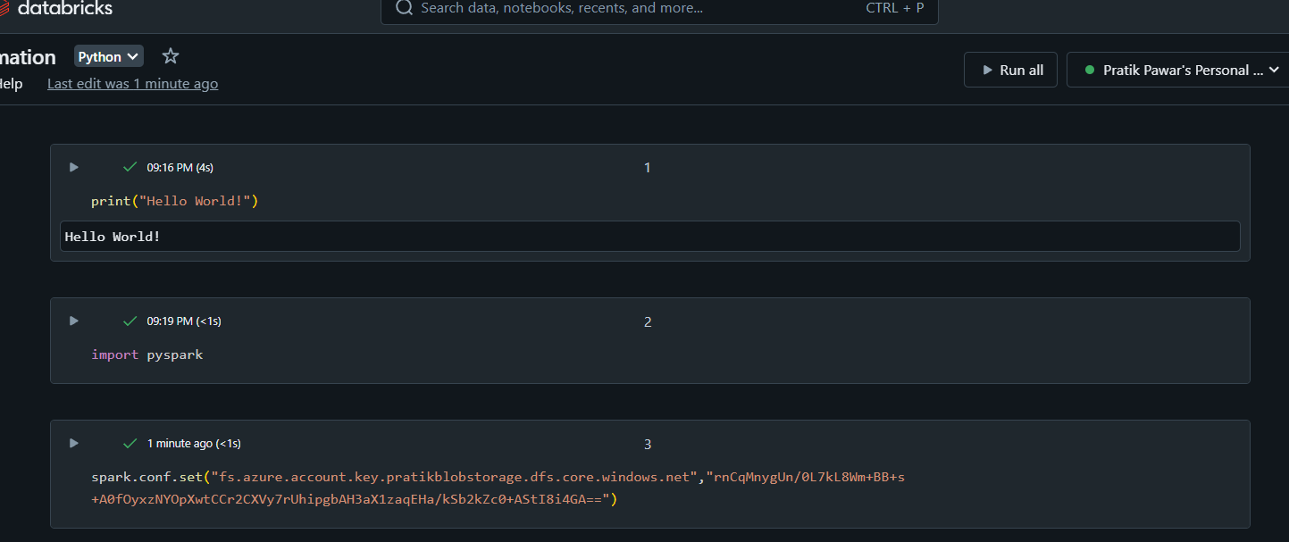
Now this is Code (Remember) to load Data from Blob and after this code give comma and inverted comma paste access key

Slide 25
Now access key is paste here, just run the code

Slide 26
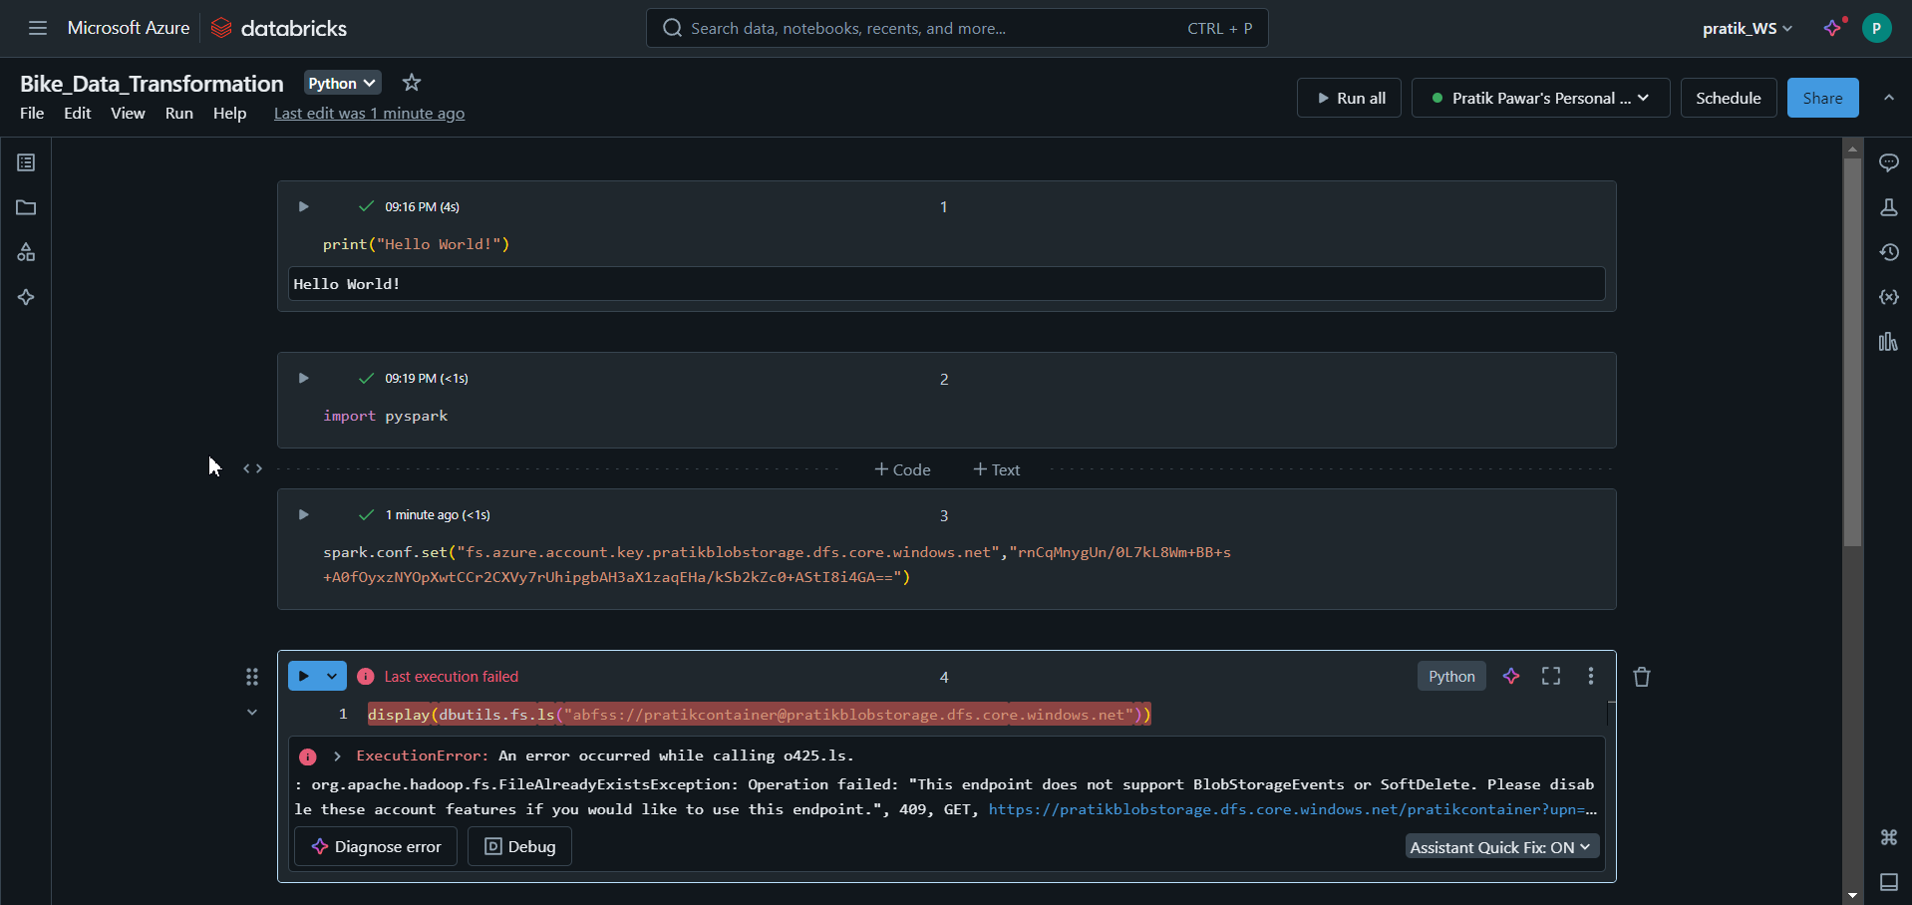
Now to display the data files we need to use ‘display(dbutils.fs.ls(..)’ to see files but we have to disable soft delete settings from Blob storage to access it (ls = list , fs = file system , dbutils = library)

Slide 27
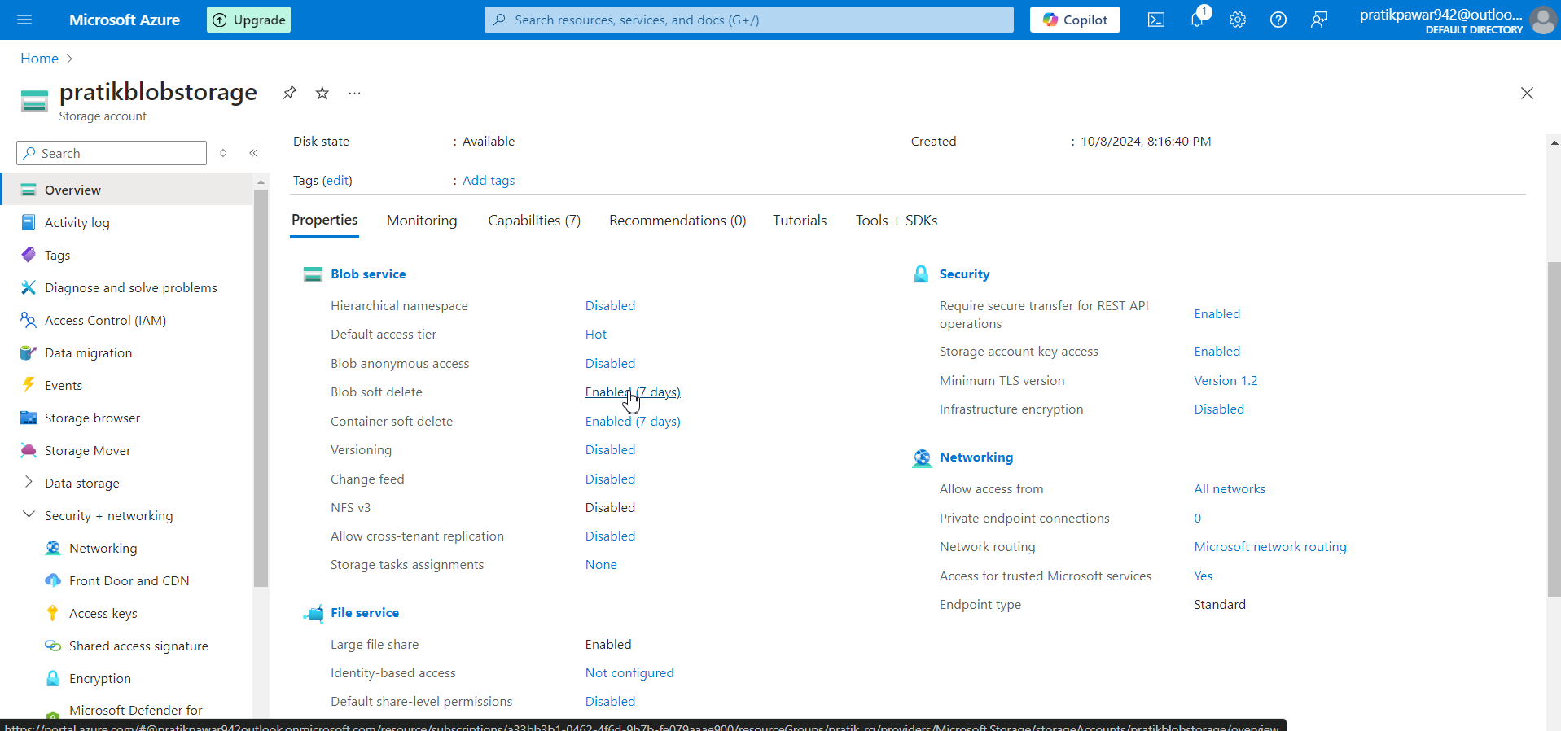
Pratikblobstorage > Blob soft delete

Slide 28
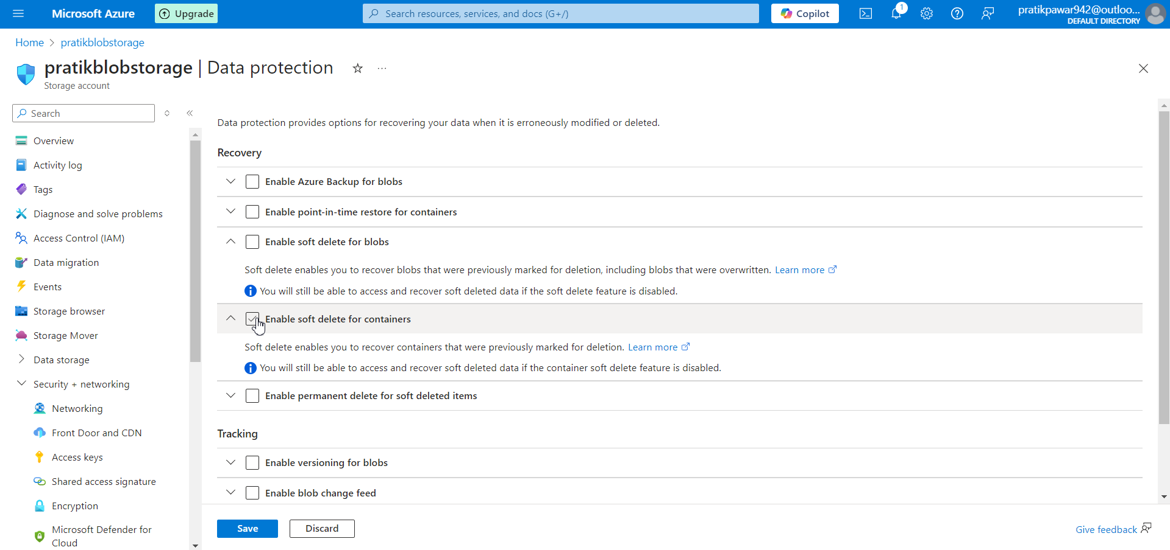
Disable both options and save

Slide 29
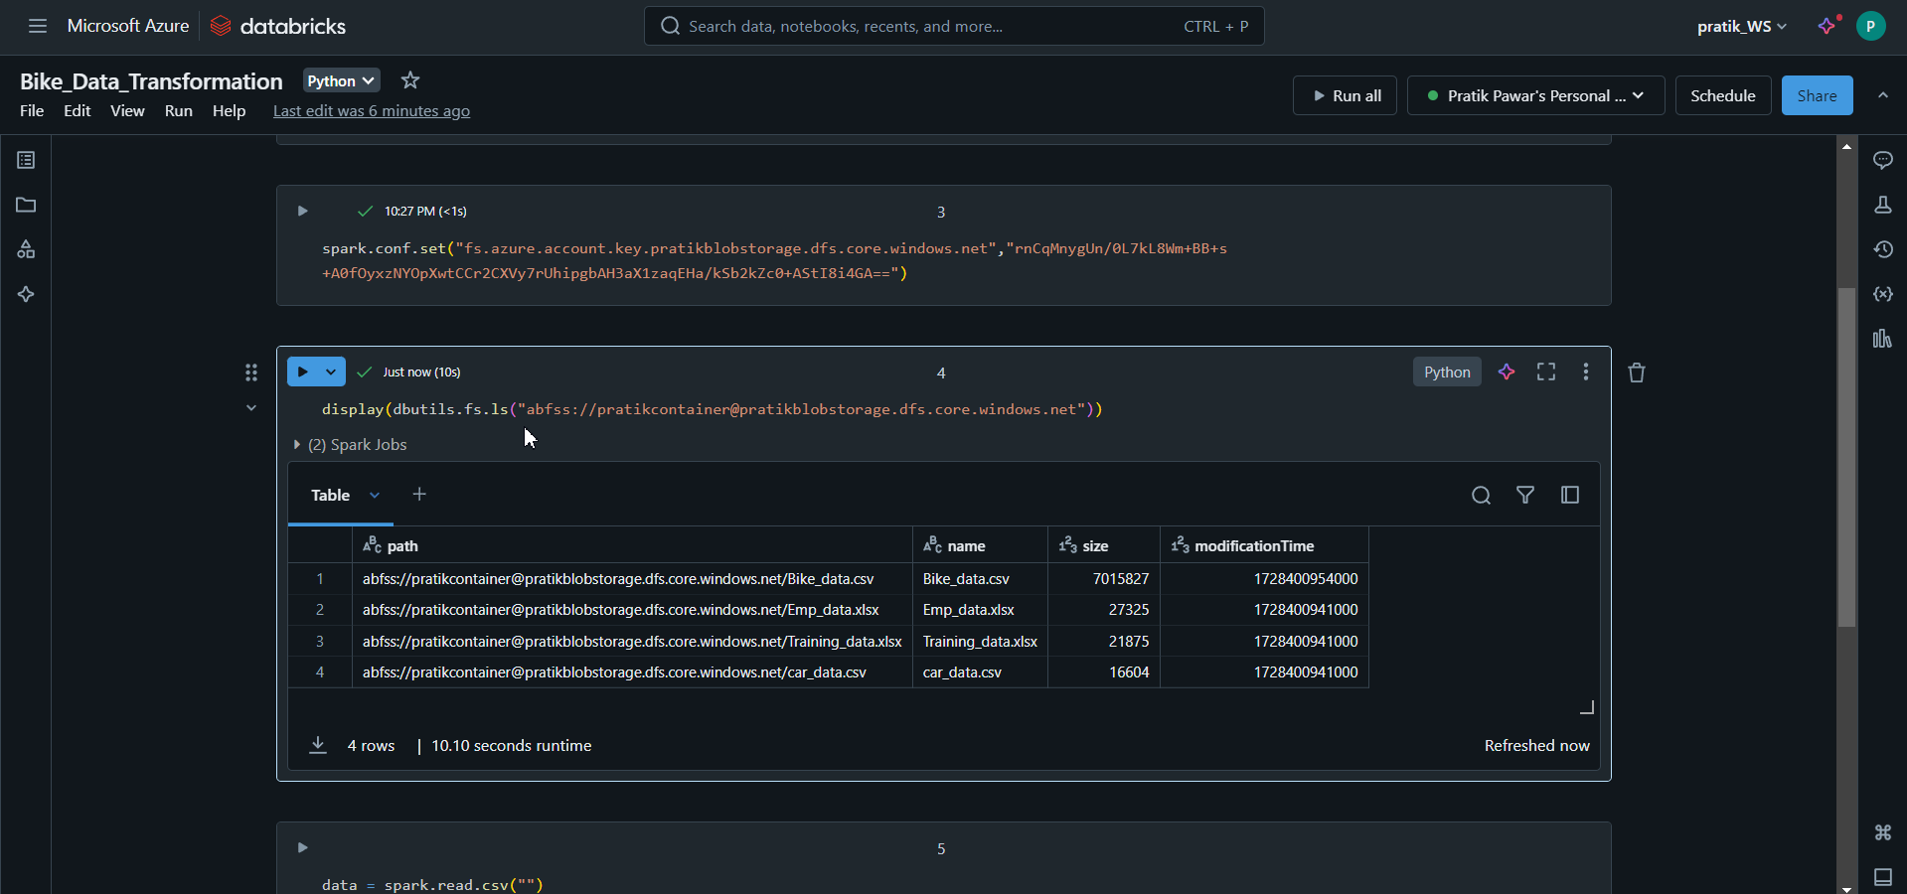
Now in this way we can see the files from Blob and use their path

Slide 30
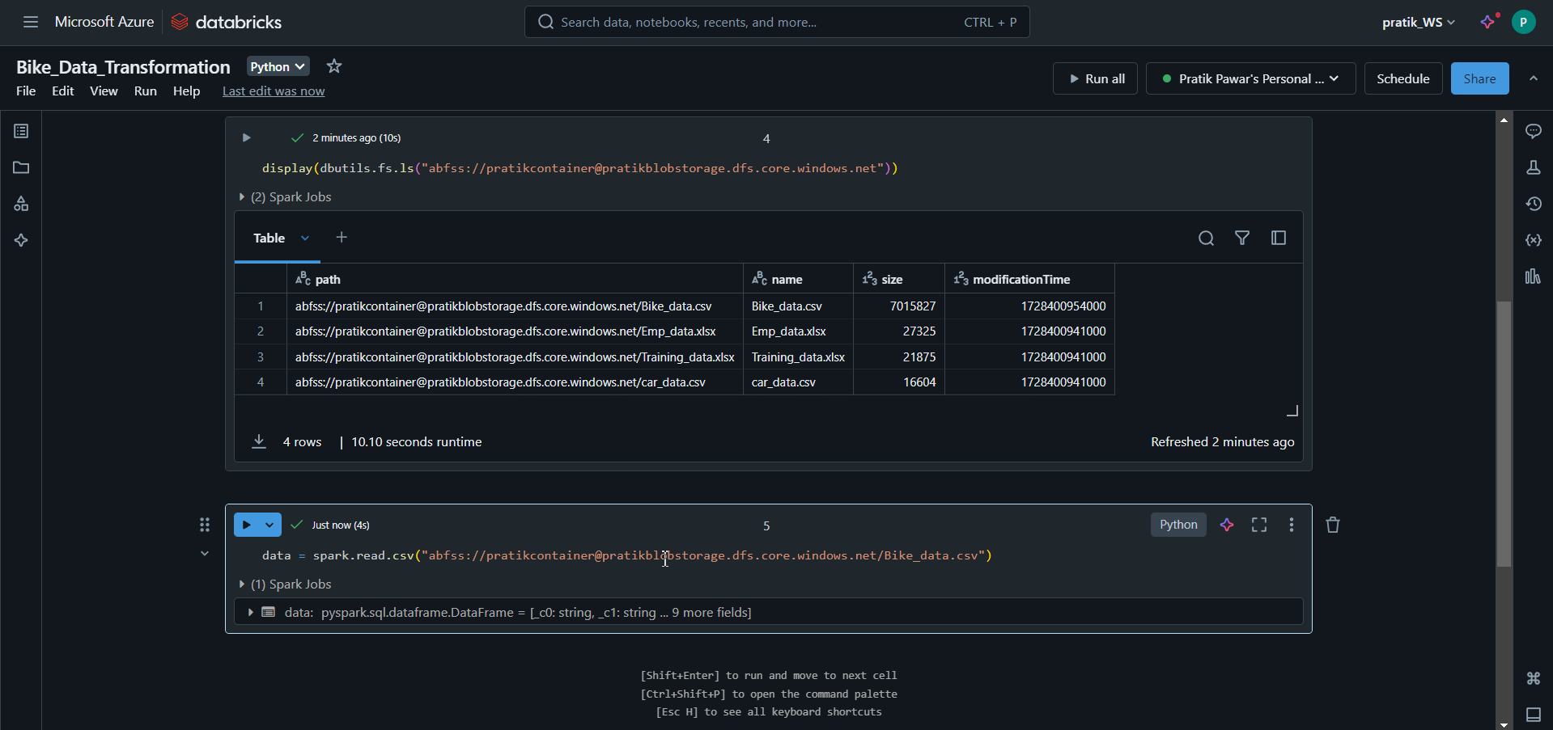
Now just use spark read command and use the path of file we want ie Bike_Data > Run

Slide 31
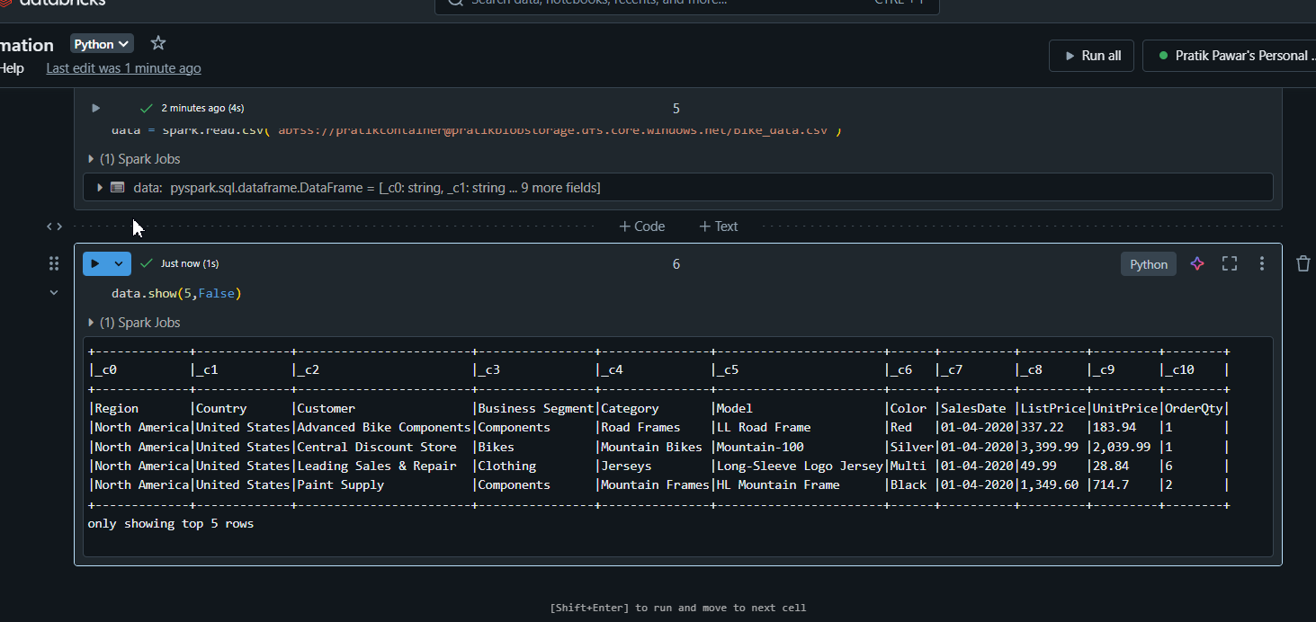
Data has been loaded

Slide 32
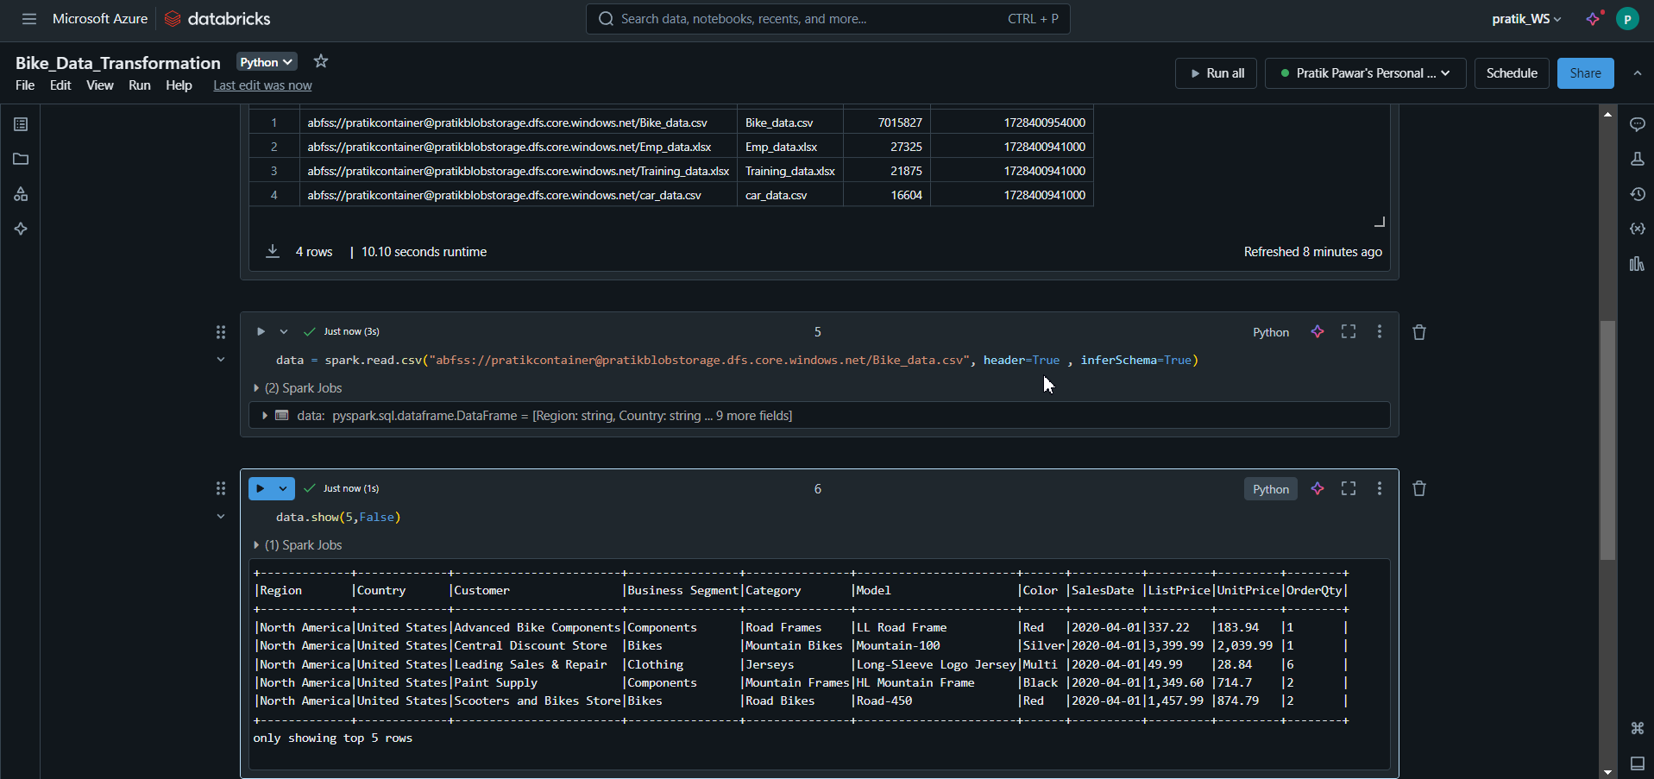
Just add header = True and Inferschema = True > Run

Slide 33
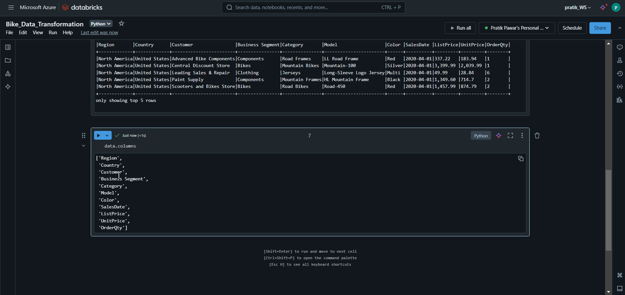
Lets see all columns ‘data.columns’

Slide 34
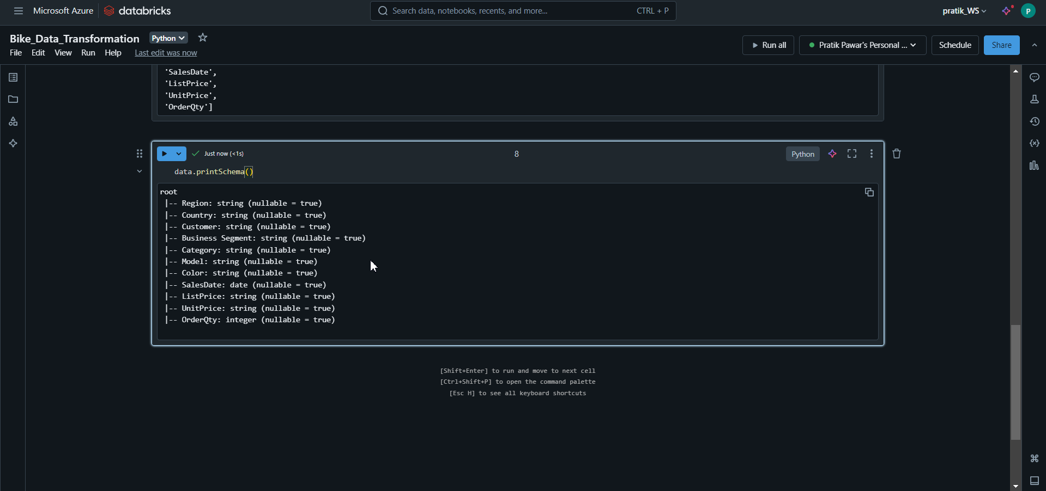
Data Types of All columns

Slide 35
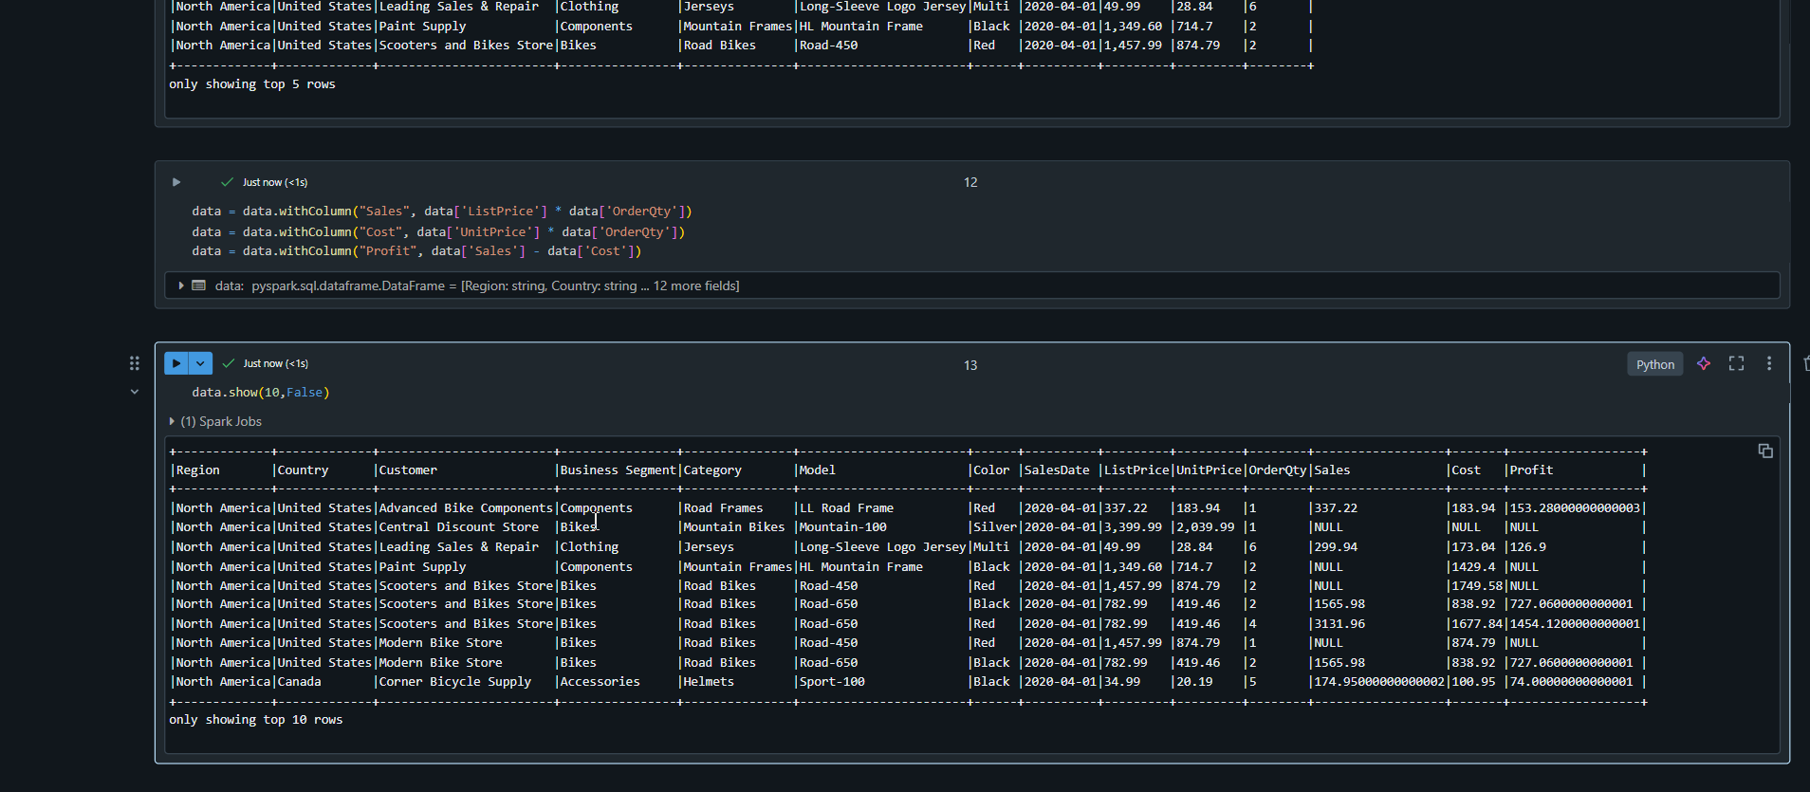
We have added sales, cost and Profit Column. Lets assume our transformation is done ( Just for Practice)

Slide 36
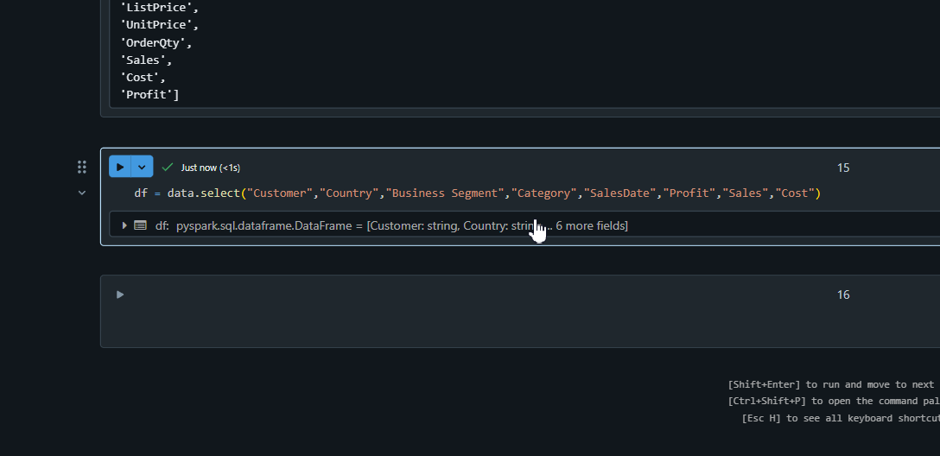
Now we have created df of required columns so will move it to SQL Database

Slide 37
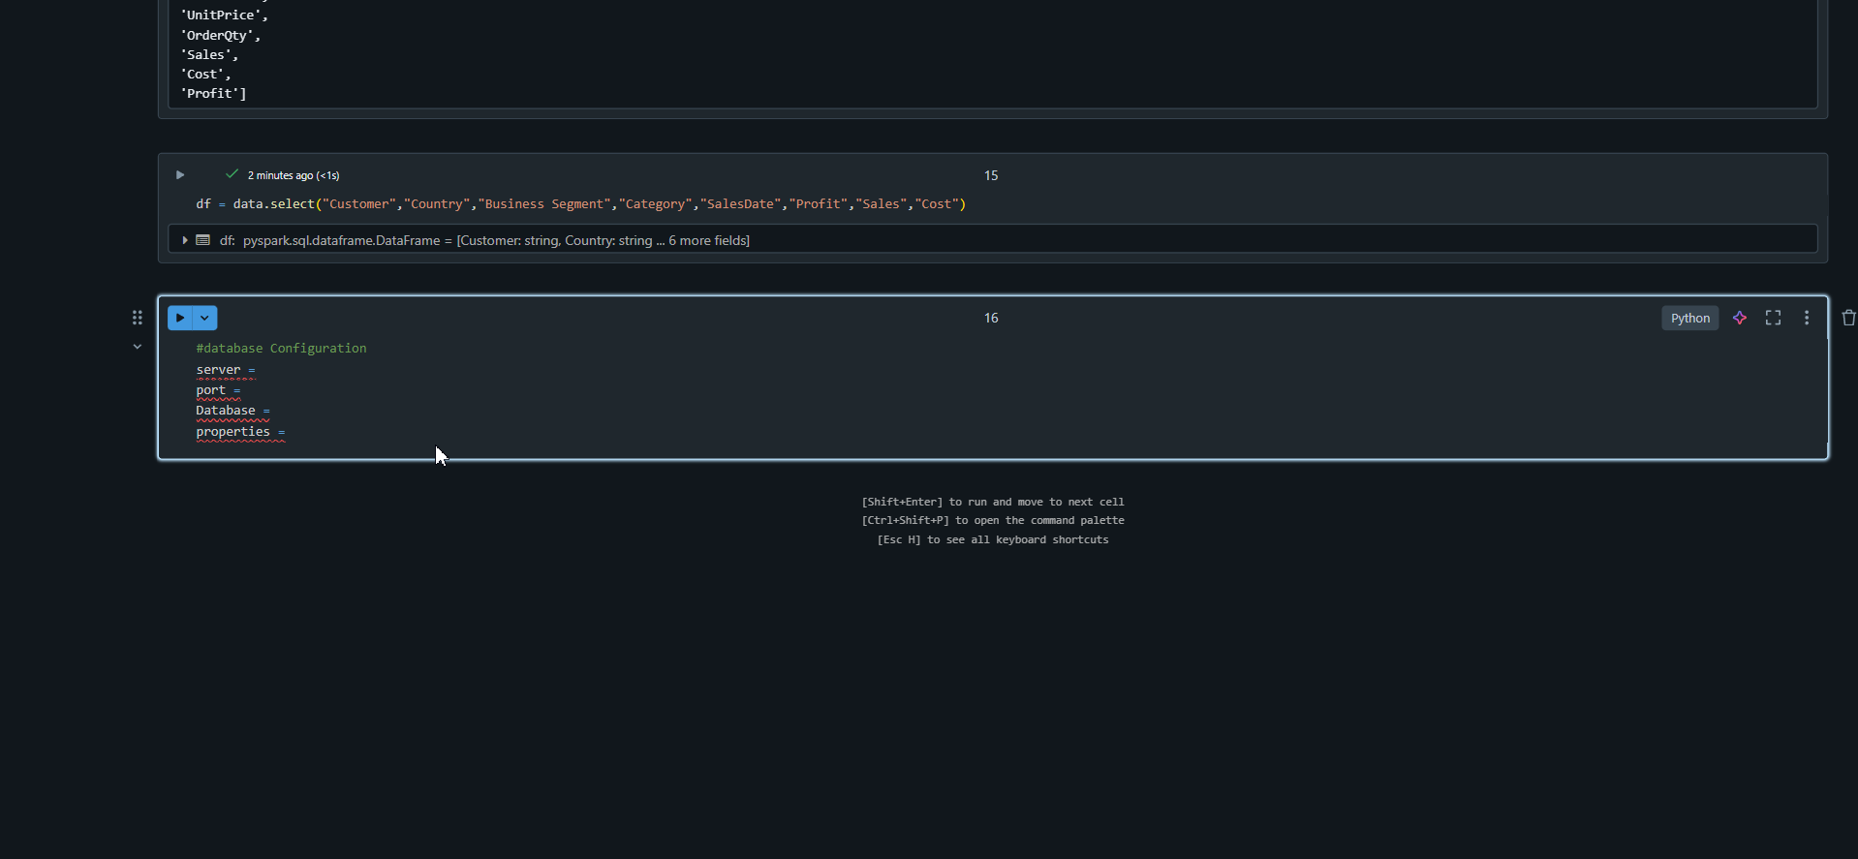
Database Configuration of SQL Database

Slide 38
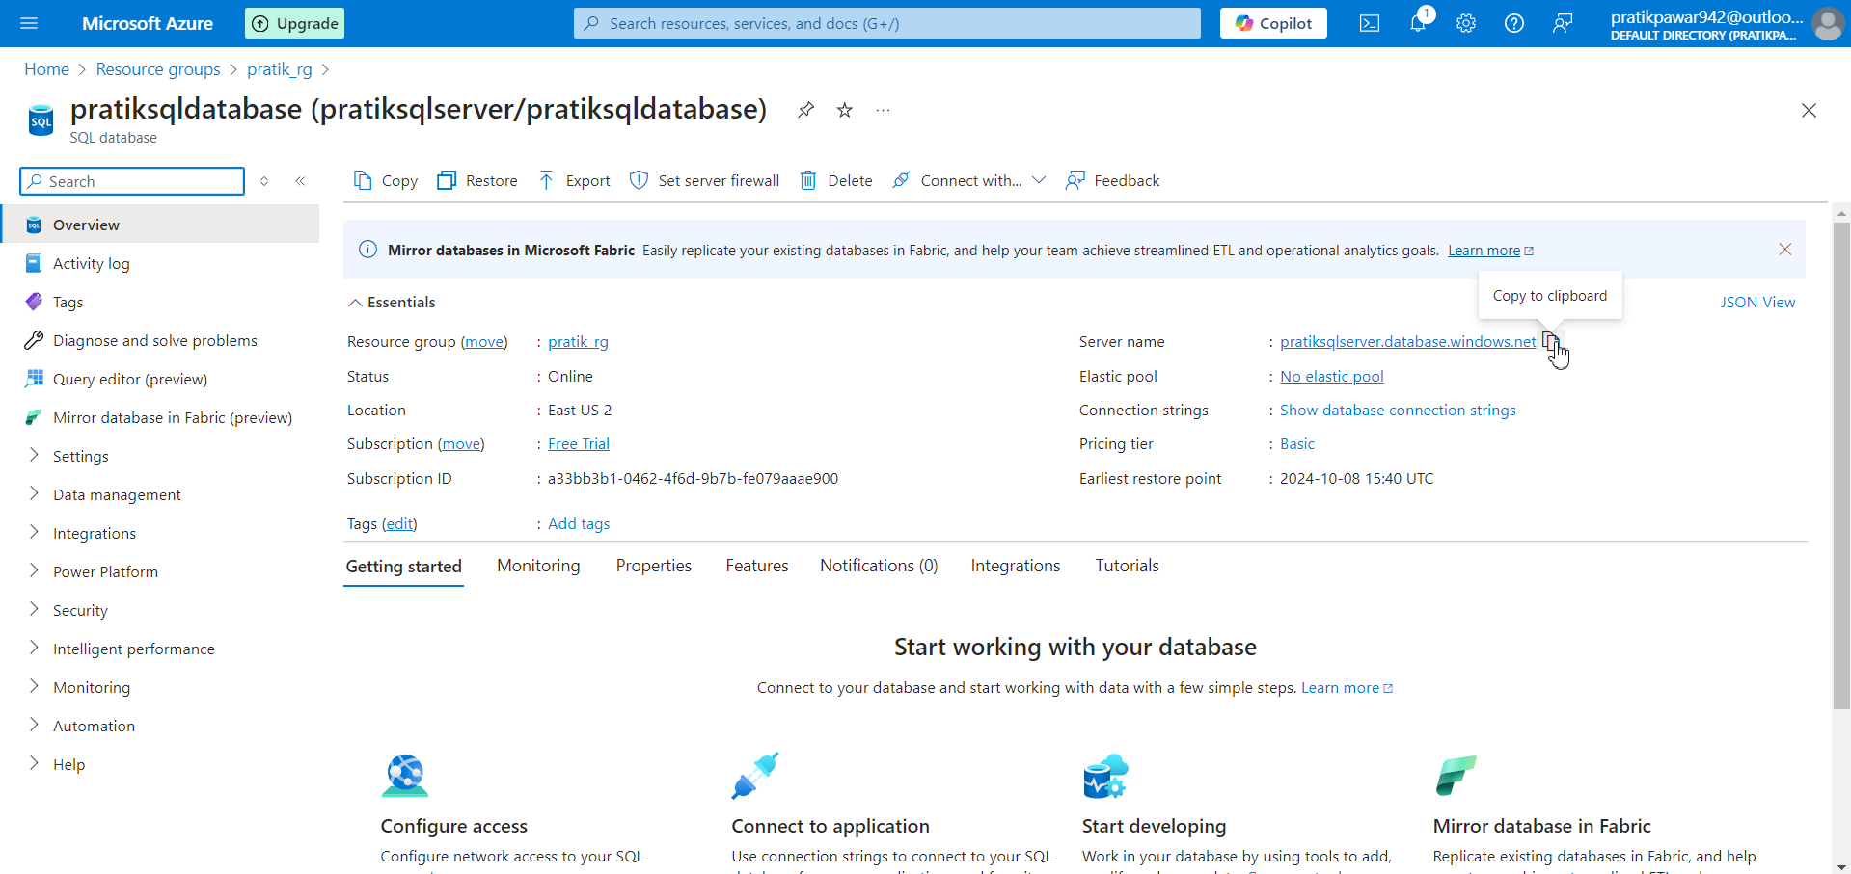
Copy server and paste in Server (Code) in Workspace

Slide 39
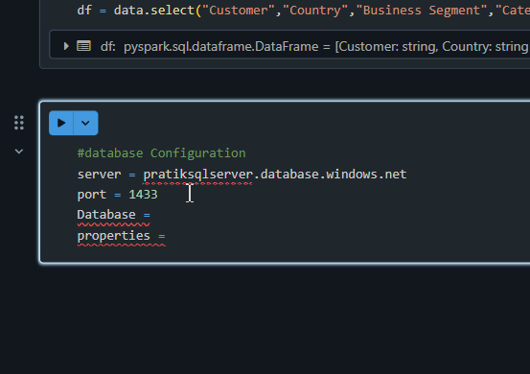
Default port is 1433

Slide 40
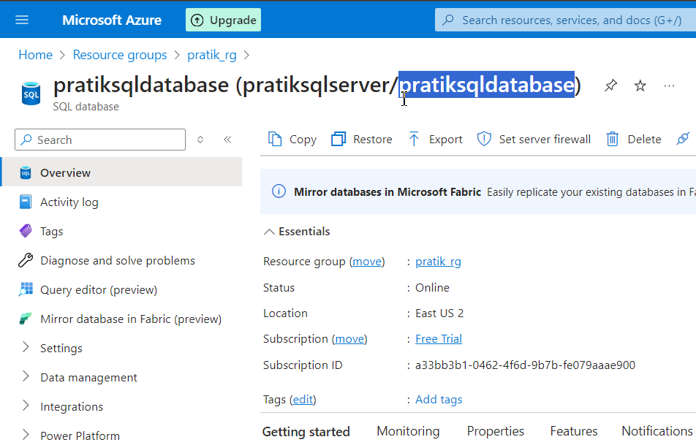
Database = pratiksqldatabase

Slide 41
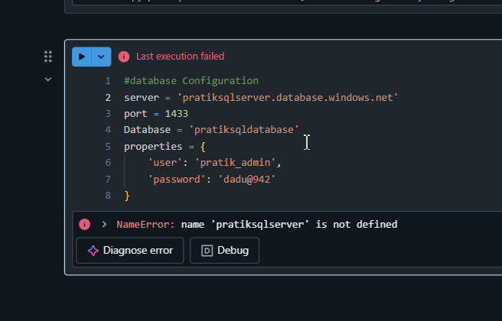
Now properties is sql query editor user name and password, we have to write in Dictionary Form > Run

Slide 42
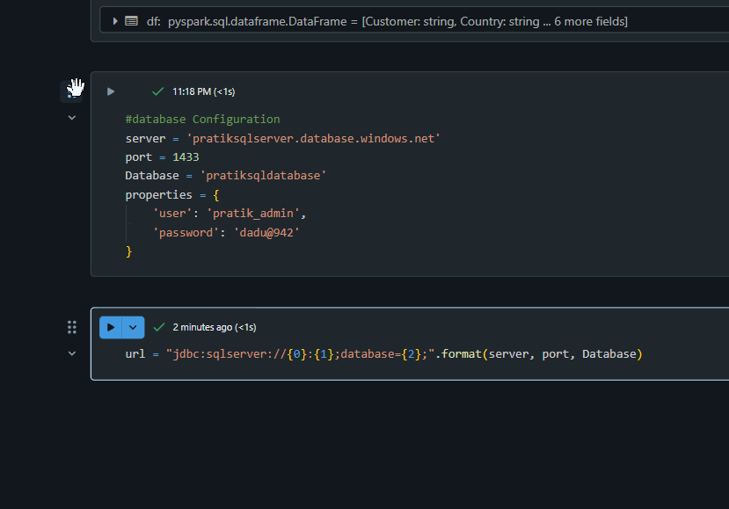
Now write url and ‘jdbc’ string that describe the connection info for connection Databricks and SQL Database in this format

Slide 43
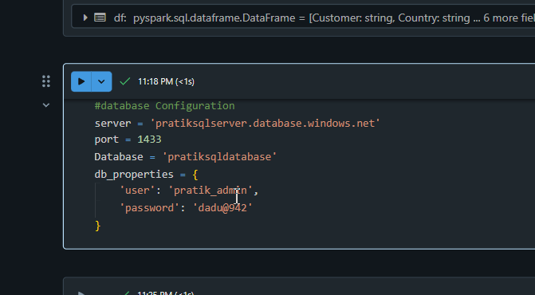
Now if we type print (url), it will show the connection location [just replaced properties with ‘db_properties’]

Slide 44
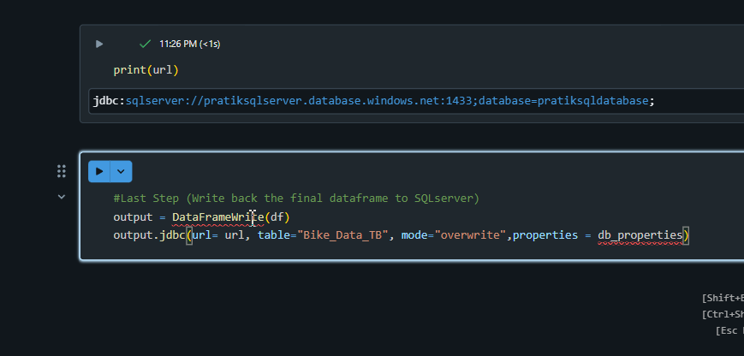
Write data to SQL server(Code)

Slide 45
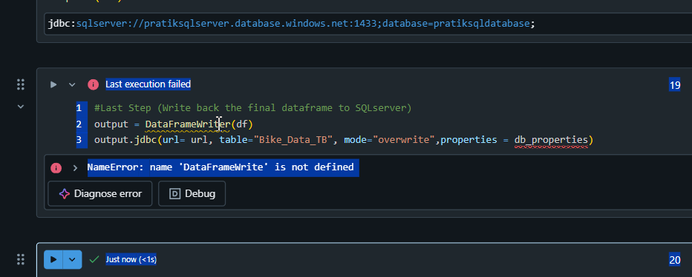
For this we have to run library

Slide 46
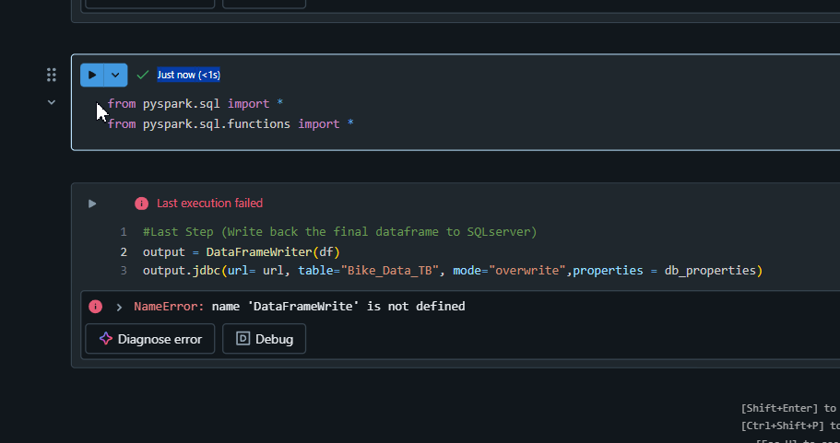
Imported all library lets try again

Slide 47
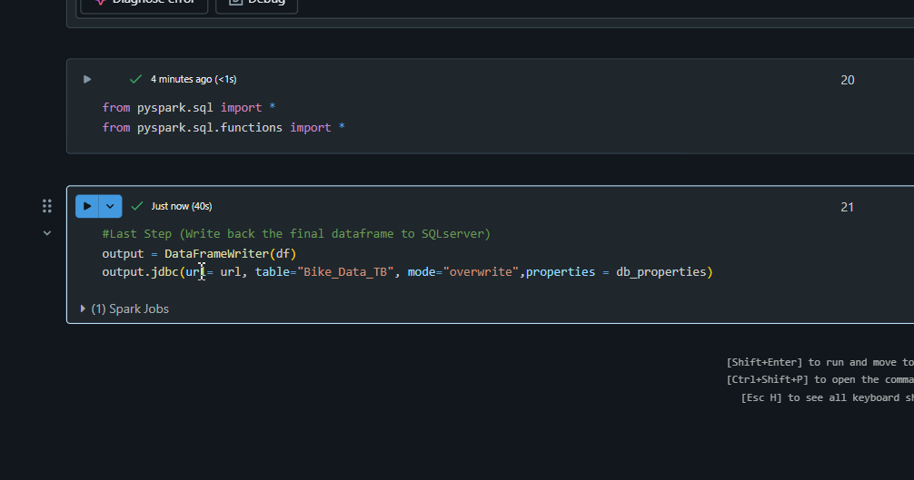
Success lets check into SQL Server

Slide 48
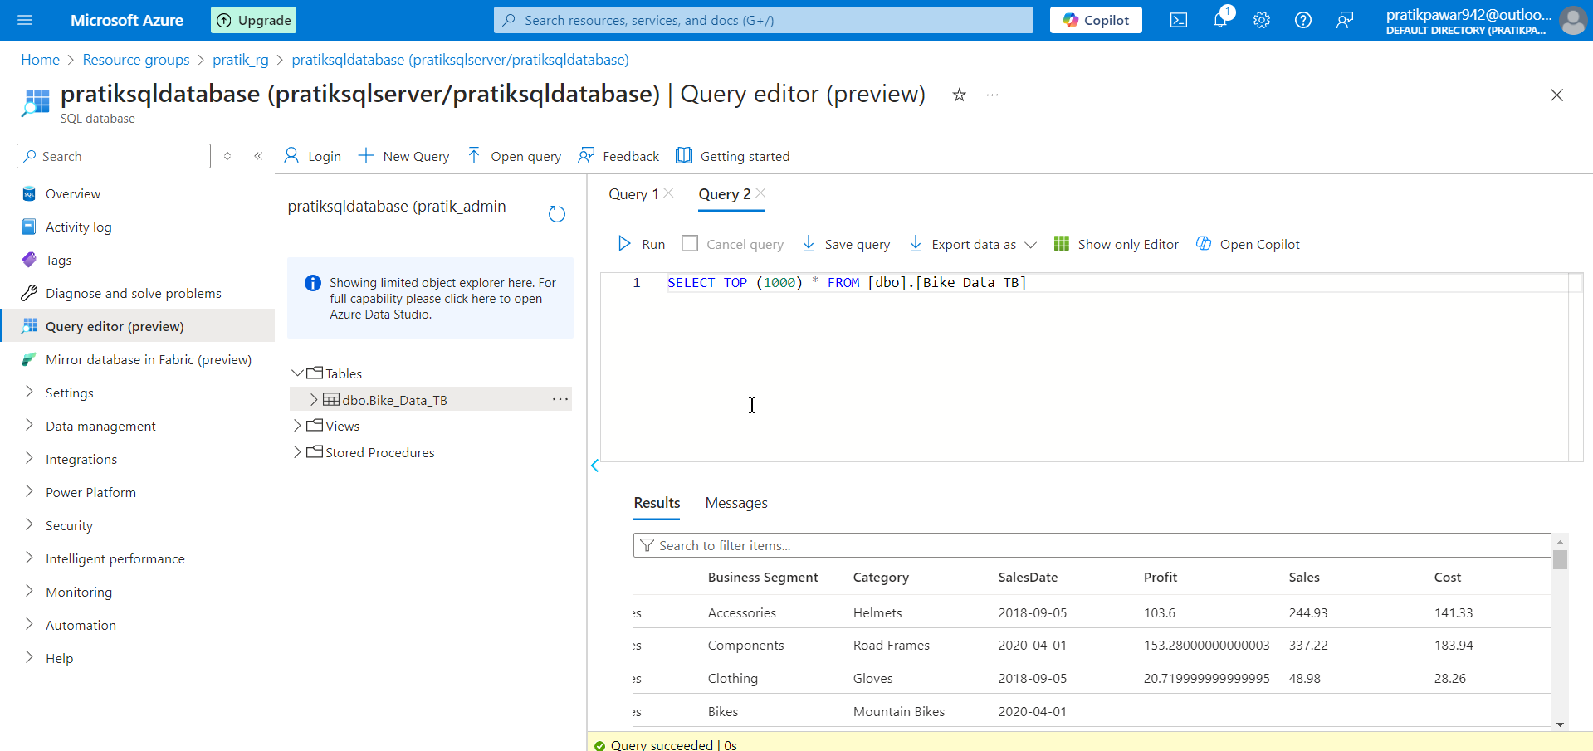
Finally Data is Write in SQL Database

